Slide 1
DIWALI
Deepawali

Slide 2
Deepawali (Diwali)
The meaning of Deepawali in Sanskrit is “ Row of Lights”
It is also called the “Festival of Lights”
Depicts “Victory of Good over Evil”

Slide 3
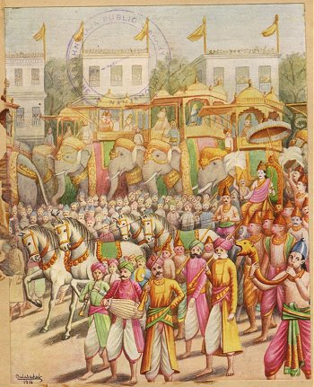
Why we Celebrate Diwali
King Ram's return to Ayodhya
King Ram won an epic war with Ravana, the king of demons in Lanka.
With happiness of the return of their king after 14 years of exile, the whole city of Ayodhya was lighted up with rows of lamps.

Slide 4
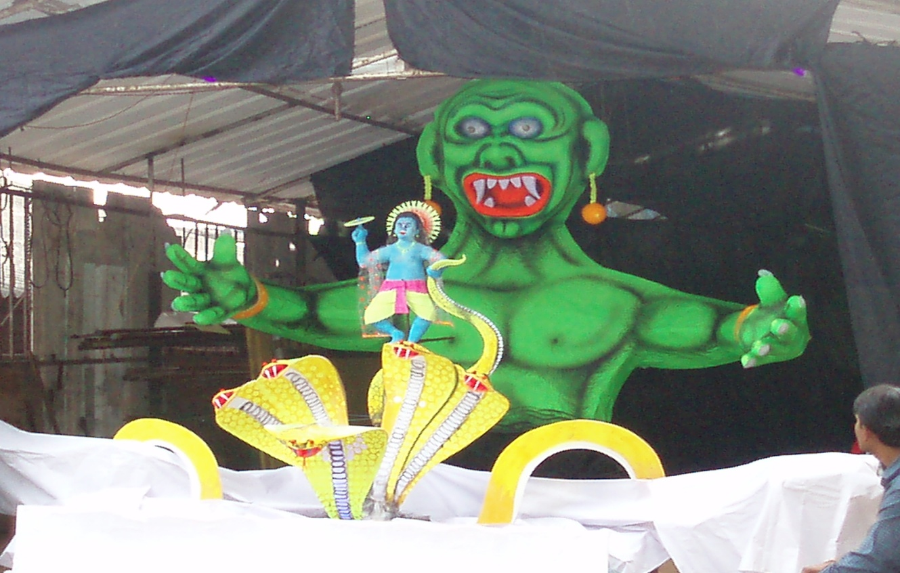
Destruction of Narakasura
Narakasura, who was a monster created havoc among the gods and the sages by disturbing their penance or by creating havoc during religious rituals.
Dejected by the trouble caused by him, all the gods went to Lord Krishna and pleaded him to protect them from "Narakasura".
Satyabhama (sister of lord Krishna) appealed to Krishna to give her the opportunity to destroy Narakasura. Narakasura had a curse on him that a woman would kill him.
Satyabhama kills Narakasura, in the battle field. This depicts the victory of good over evil. Since then, Diwali is celebrated by people every year with great joy.

Slide 5
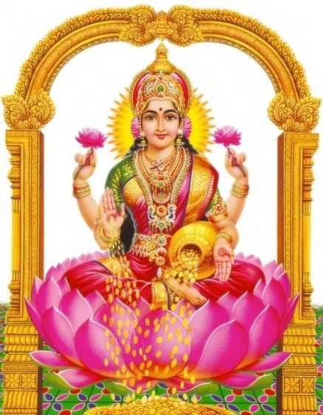
Goddess Lakshmi emerged from the ocean of milk
Goddess Lakshmi emerged from the ocean of milk which is called the Ksheer Sagar. She brought wealth and prosperity for mankind with her.

Slide 6
How do we celebrate Diwali
First day: Dhanteras or Dhantryaodashi
Second Day: Narak Chaturdasi
Third Day: Diwali
- Houses are lit up with Diya and decorated with Rangoli
- People pray to Goddess Lakshmi
- Children and adults burst Firecrackers and exchange sweets and gifts

Slide 7
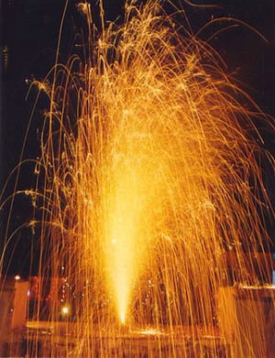
Children bursting Firecrackers

Slide 8
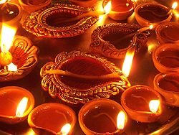
Happy Diwali

